Slide 1

StudyBuddy

Slide 2



StudyBuddy
Problem
Many students struggle to know how well they are learning when studying on their own.
They often take notes, but it’s hard to tell what topics they truly understand or where they need more practice.
Most quiz platforms online are teacher-driven or rely on pre-made questions, leaving self-learners without personalized practice or feedback.

Slide 3
StudyBuddy
Eldad is developing a learning tool for self-learning students
Students can take notes, generate quizzes from notes or uploaded
PDFs, and plan and manage their study schedules.
The platform also includes admin controls to manage access and usage,
since the AI study buddy runs on a paid API key

Slide 4



StudyBuddy
USERS
Students
Administrator

Slide 5
StudyBuddy
BIO
Meet AKUA
Akua is a self-learning student who studies independently and wants a better way to check her understanding, practice what she learns, and stay organized while preparing for exams.
Goals
Challenges
Understand her study materials better
Know which topics she has mastered and which need more practice
Study efficiently and stay organized
Hard to measure real understanding when studying alone
Limited access to personalized quizzes and feedback
Struggles with planning and managing study time
How Helps
StudyBuddy
Lets her write notes and organize them in folders
Automatically generates quizzes from her materials
Provides progress tracking from quiz results
Helps her plan and manage her study schedule

Slide 6
StudyBuddy
BIO
Meet AMA
Ama manages the StudyBuddy platform and is responsible for controlling user access, monitoring system usage, and ensuring the AI features are used efficiently and responsibly.
Goals
Challenges
Ensure the platform runs smoothly
Control and monitor AI usage
Manage user access and system availability
Managing costs tied to a paid AI API
Preventing misuse of the system
Ensuring a good experience for all users
How Helps
StudyBuddy
Provides admin controls to manage users
Monitors site usage and AI activity
Controls when and how the system is available

Slide 7
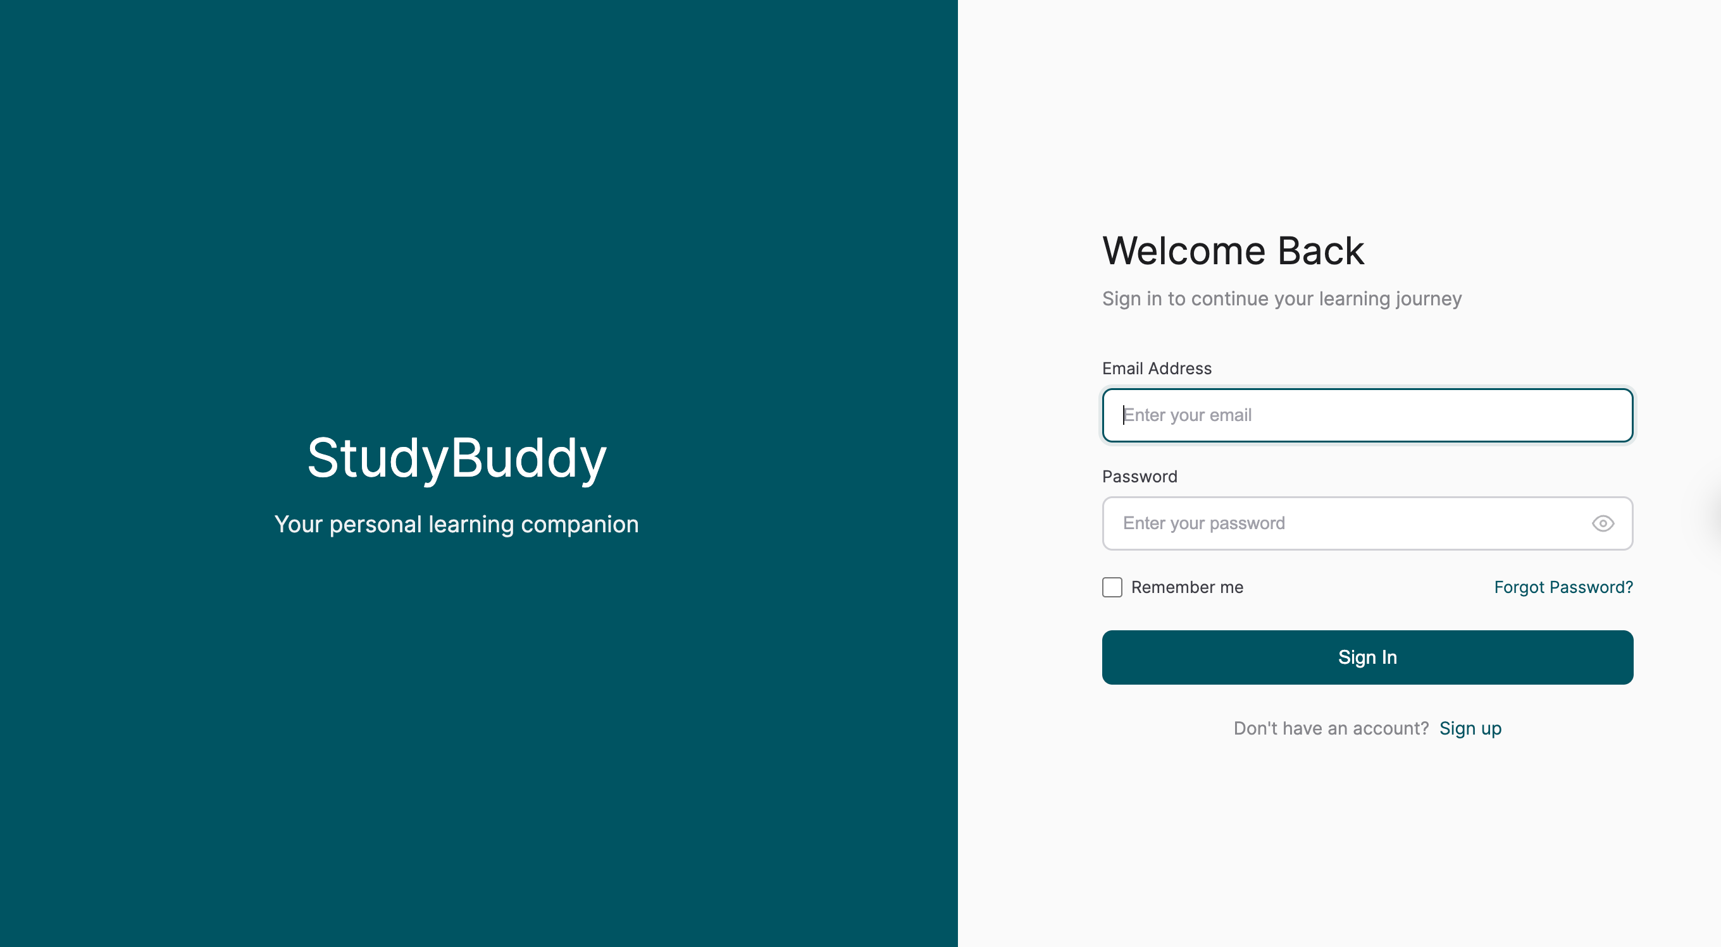
StudyBuddy
Buddy Chatbot
Folder Management
Main
Functionalities
There is a simple chatbot, Buddy that uses the same GROQ API for the quiz generator to answer questions study have when learning
Students are able to store and organize their notes in folders for ease of access
Note Taking
Quiz Generator
Students are able to take simple
notes in class or when learning and have them saved in StudyBuddy for revision or quiz generation
With a GROQ API, and pdf text extraction, students get MCQ AI quizzes from buddy either from a prompt or topic they give, their notes, or an uploaded pdf
Scheduler
Admin Overview
Students have access to a simple calendar feature to create events or study schedules they will follow
Administrators get to view all the students on the site, the total quizzes and notes done and delete some accounts if malicious

Slide 8










StudyBuddy
Architecture
Front End
Back End
Database
Hosting Services
AI API

Slide 9
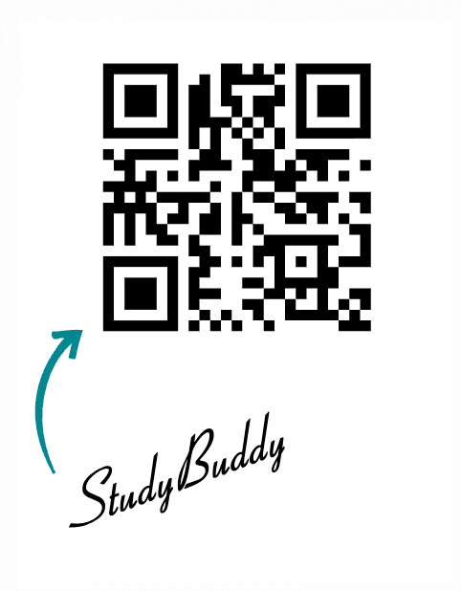
StudyBuddy
Getting Started
Scan
Link: studybuddy-six-blush.vercel.app

Slide 10
Thank YOU!
StudyBuddy

